Slide 1

Data Science Lab Innovations June 2022

Slide 2

Hello!
I am Syed Javedhussain
You can find me at sj565@exeter.ac.uk

Slide 3
1.Who Am I ?

Slide 4
I’m a Data Engineer and my roles and responsibilities are finding trends in data sets and developing algorithms to help make raw data more useful to the enterprise.

Slide 5
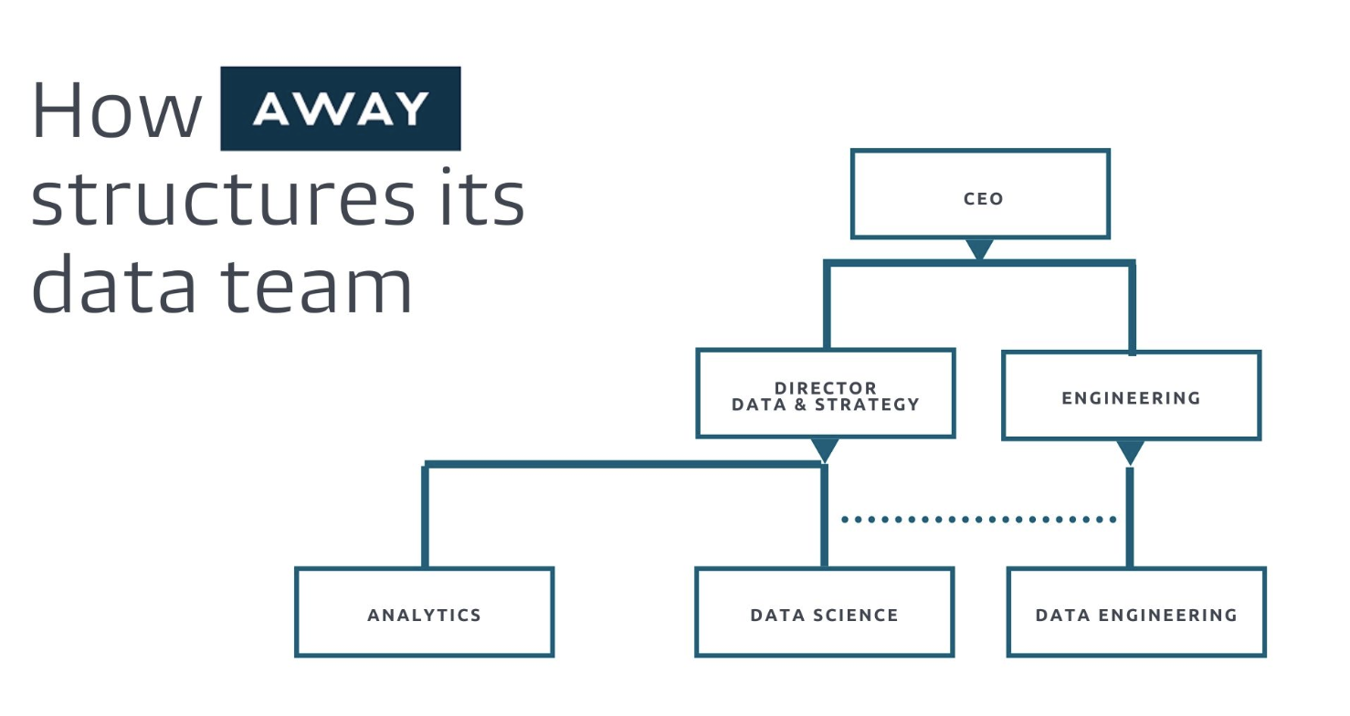
Organization Chart

Slide 6
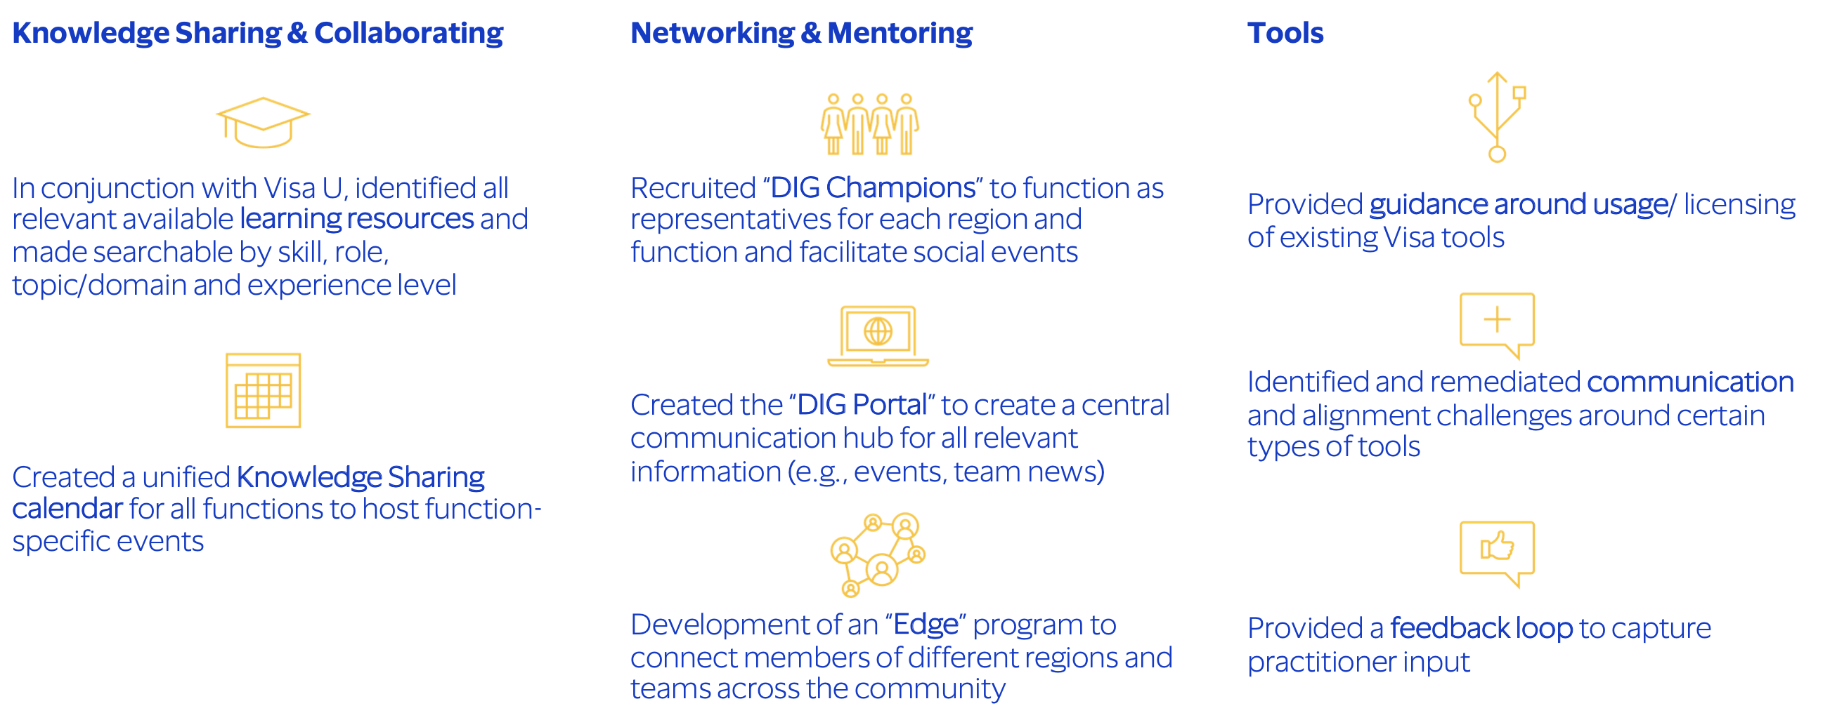
Data Community Program

Slide 7
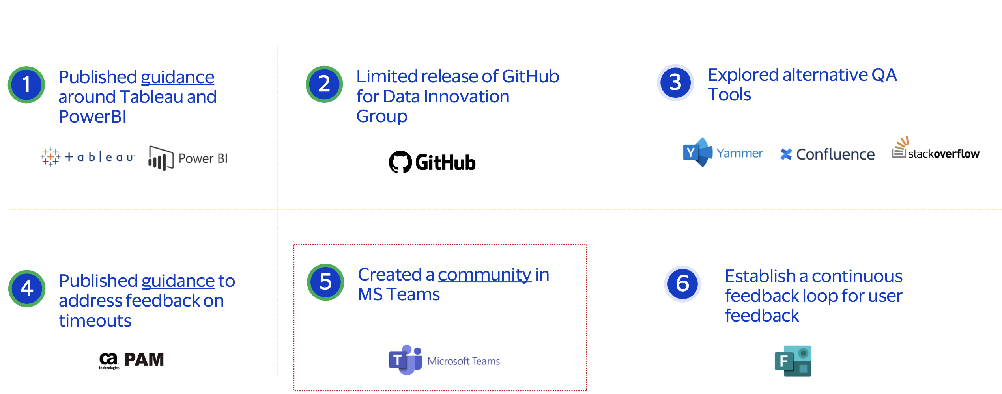
Tools Workstream

Slide 8
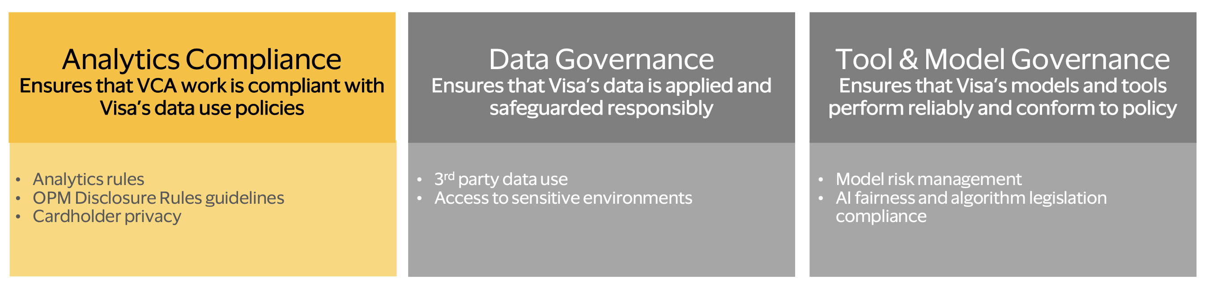
Data Compliance Center

Slide 9
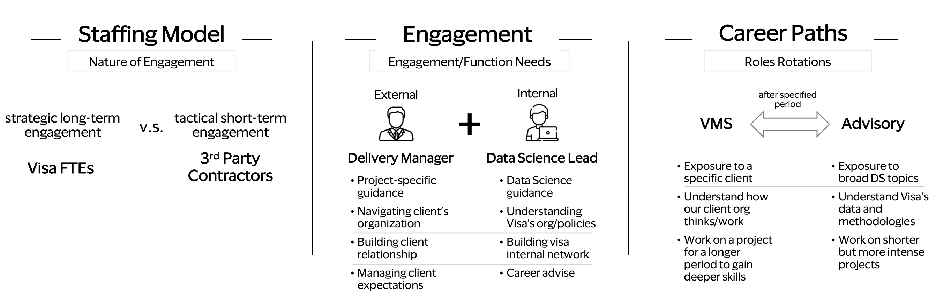
Managed services talent program

Slide 10
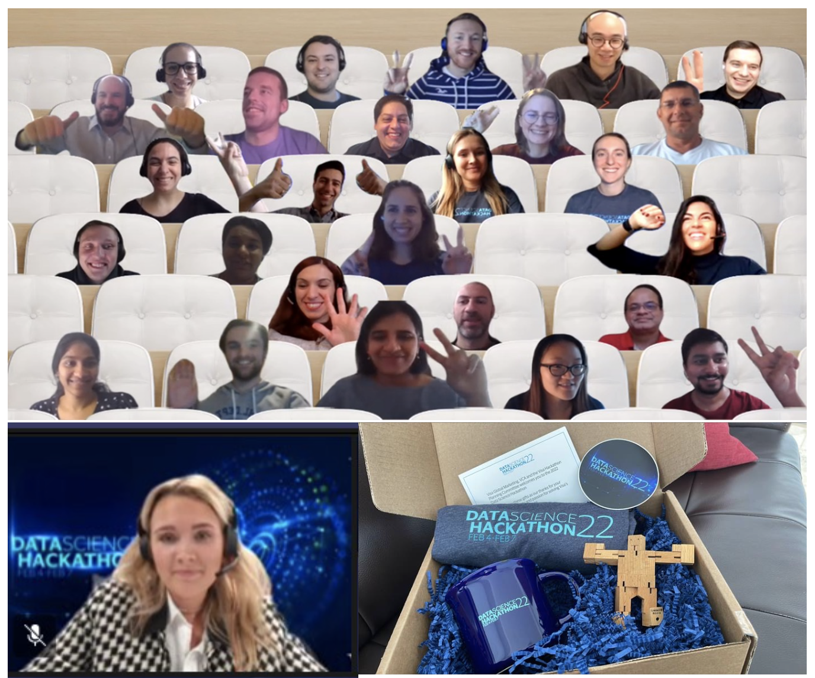
Hackathon 2022

Slide 11

Thanks!
Any questions?
You can find me at
sh565@exeter.ac.uk

